Slide 1
.Net Framework and C#
Introduction

Slide 2

.Net Framework
Provides services and programming interfaces
Read/Save info into a database
Read an XML file
Cryptography
Configuration
Network Communications
…
Etc.
Core features for every application
Application

Slide 3

.Net Framework Components
Common Language Runtime
(CLR)
Framework Class Library
(FCL)

Slide 4
Common Language Runtime
CLR
Execution environment for .Net applications
Manages the application lifecycle
CoreCLR
Memory management
macOS
Linux
Hardware and Operating System
Support multiple languages
C#, VB or F#

Slide 5
Framework Class Library
FCL
Contains reusable software for develop applications
Helps to write software
Desktop applications
Web applications
Web services
Mobile apps

Slide 6

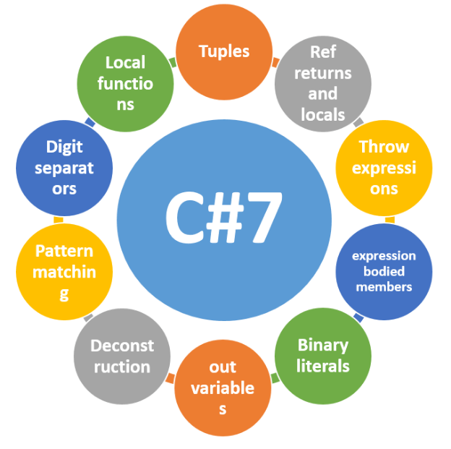
C# Language
Language for .Net
Syntax inspired by C++
Strongly typed
Case sensitive
Object-Oriented

Slide 7
C# Code Compiler

Slide 8

C# Compiler
File.cs

Slide 9
C# Compiler
File.cs
C# Compiler (CSC)

Slide 10
C# Compiler
App.exe
File.cs
C# Compiler (CSC)
CIL Instructions
Common Intermediate Language
(CIL)

Slide 11
C# Compiler
CLR
App.exe
File.cs
C# Compiler (CSC)
CIL Instructions
Common Intermediate Language
(CIL)

Slide 12
Q&A

